Slide 1
Bird Species Image Classification
Members: John
Khoa
Eddie
Boyu
Notes:
“Hi everyone, we’re presenting our project on bird image recognition using computer vision.
In this presentation, we’ll show how we approached the problem, what models we used, and the results we got from trying to recognize different bird species from pictures.”

Slide 2
Research Problem
Research Problem: Bird Species Image Classification
Goal | Challenge | Variability | Research focus
Build an AI model that can identify bird species from photos. | Many birds look very similar, with only small changes in color, feathers, or beak shape. | Images vary a lot in lighting, angle, and background, and the dataset is small and uneven. | Test how different model types (simple CNN vs ResNet50) handle complex, real-world images and limited data.
Compare how simple CNNs vs ResNet50 perform on the same data. | Subtle features make it hard for a model to learn the right details. | These variations make it difficult for AI to generalize to new bird photos. | Use these findings to improve accuracy and generalization for bird recognition tasks.
Notes:
Our goal was to identify different bird species from images.
We tested different AI models on the same dataset to see how they perform.
We started with a simple CNN — a convolutional neural network that learns to recognize patterns like edges, colors, and shapes in images.
One challenge was that our dataset was small, and the bird photos had different lighting and backgrounds.
So next, we tried transfer learning using a pretrained model called ResNet50 to see how it could improve accuracy.”

Slide 3
Why we picked it
01
Interesting Challenge
02
Learning Opportunity
Birds look very similar, making it a good test for image recognition.
Lets us explore how AI models learn visual details.
03
Transferable Skills
04
Techniques apply to other image tasks like plants or animals.
Manageable Scope
Small dataset that fits our class project timeline.
Notes:
“We chose this topic because I’ve always found image recognition really interesting.
Birds are also a great challenge — many species look very similar, so it forces the AI to focus on small details like color, beak shape, and feathers.
It’s also a fun project since there are lots of public bird image datasets we could use, and it shows how AI can recognize real-world images.”

Slide 4
Dataset and Setup
Dataset | Setup | Metrics | Tools
Mercury is the closest planet to the Sun | Despite being red, Mars is a very cold place | Jupiter is a gas giant and the biggest planet | Venus is the second planet from the Sun
• Kaggle Bird Species Classification dataset | • Trained using Google Colab | • Accuracy – overall model performance | • TensorFlow / Keras for model building
• 250 labeled images of different bird species | • Used train / validation / test splits | • Macro F1-Score – handles class imbalance | • NumPy / Matplotlib for analysis & plots
• Each image labeled by species name | • Ran 10 epochs with early stopping | • Confusion Matrix – shows prediction patterns | • Google Drive for dataset & results storage

Slide 5
Method 1: Baseline CNN
Overview
Model Structure
Results
•Built a simple convolutional neural network (CNN) from scratch.
•Used as a starting benchmark for comparison
•3 Conv layers → Max Pooling → Dropout → Dense output
•Activation: ReLU, Output: Softmax
•Trained 10 epochs with Adam optimizer + early stopping
•Accuracy ≈ 25 % | Macro-F1 ≈ 0.05
•Model underfit due to small dataset and no pretrained features
•Weak class separation seen in confusion matrix
This gives us a baseline benchmark for comparing future models like ResNet50 and EfficientNet.
Notes:
Our first approach was to build a baseline model using a simple Convolutional Neural Network, or CNN. We built this from scratch to establish a performance benchmark. This helps us understand the true difficulty of the problem and gives us a reference point to measure our more advanced model against.
As you can see, it has a standard, straightforward architecture: three convolutional layers to extract features, followed by a final dense layer for classification. We also included a dropout layer to help prevent it from just memorizing the training data.
This model achieved an accuracy of about 25%. The key takeaway here is that the model underfit the data. Because our dataset is small, the simple CNN struggled to learn the subtle, fine-grained differences between the bird species."

Slide 6
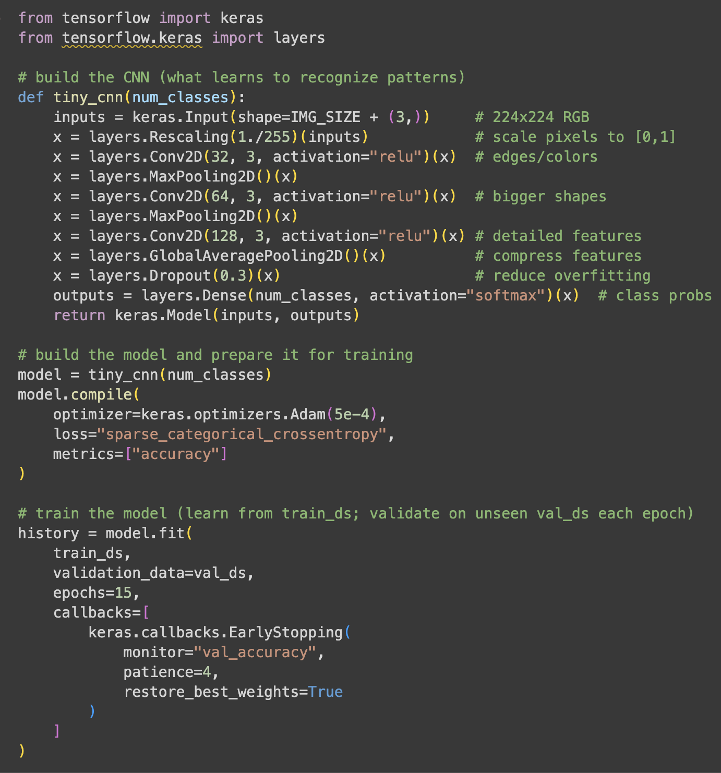
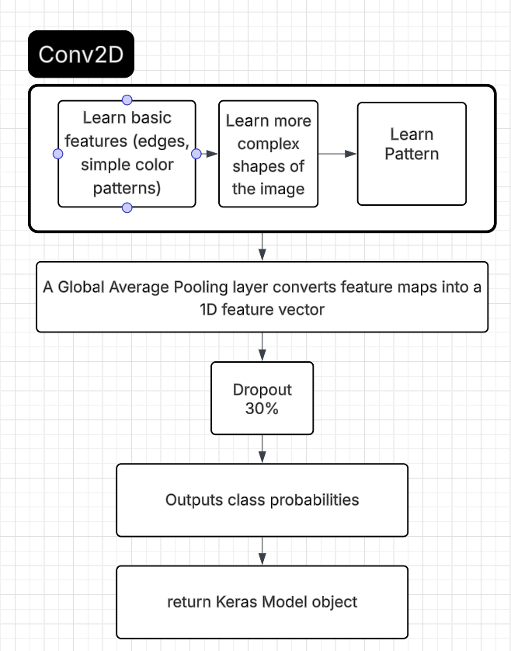
Baseline CNN (Convolutional Neural Networks)

Slide 7
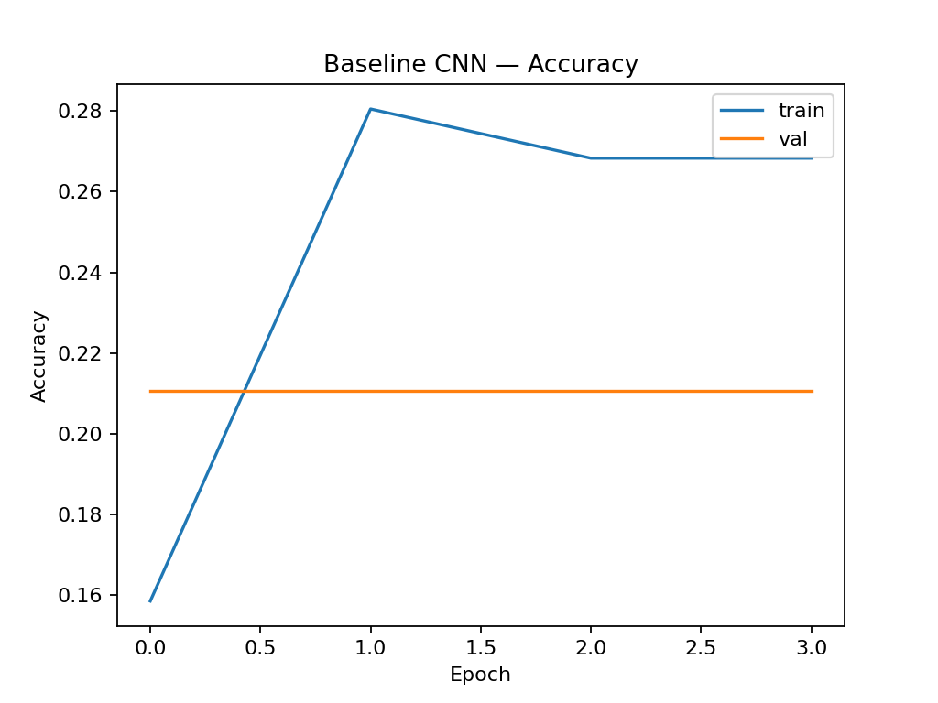
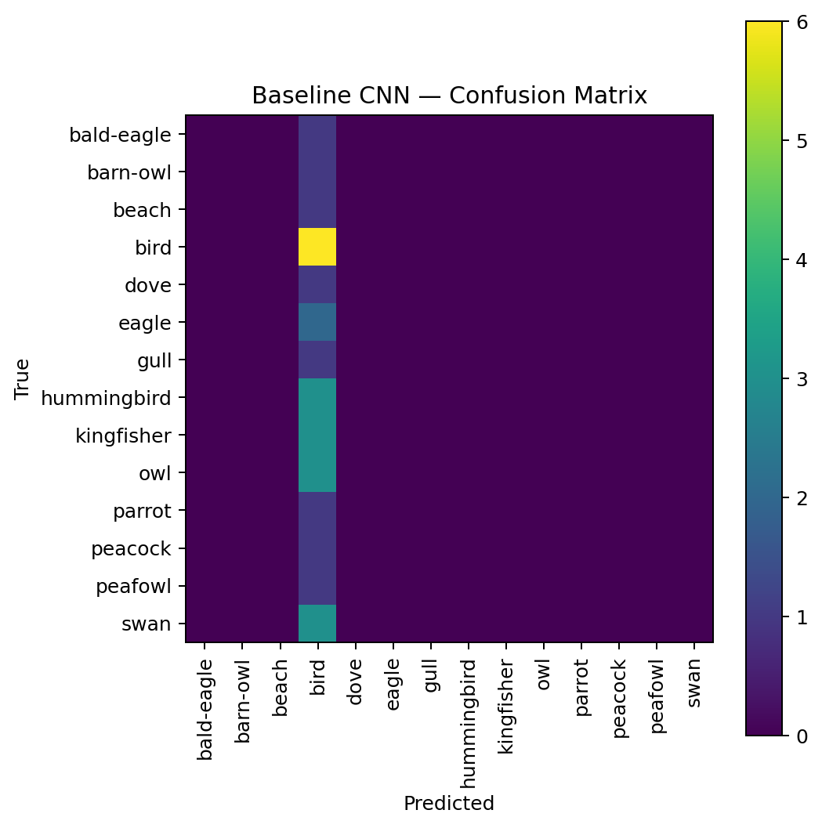
Baseline CNN Results
Venus
Venus has a beautiful name, but is also hot, even hotter than Mercury
Mars
Despite being red, Mars is a very cold place full of iron oxide dust
Notes:
Blue line (Train Accuracy)
Shows how well the model did on the training data during each epoch (training round).
It goes up at first, meaning the model is learning some patterns from the training images.
But it levels off quickly — the model stops improving early, which means it has hit its learning limit.
Orange line (Validation Accuracy)
Shows how well the model performed on new, unseen data that wasn’t used for training.
It’s flat and low, which means the model never generalized well — it couldn’t apply what it learned to new bird images.
This is a clear sign of underfitting — the CNN is too simple to handle fine differences between species.
Matrix “This is our confusion matrix — each row is the real bird, and each column is what the model guessed. Since the chart looks mostly blank and scattered instead of forming a diagonal, it means our model often guessed wrong and confused the species.” “Most predictions are scattered — the model mixed up species and failed to form a clear diagonal pattern.” For the accuracy ““So, the blue line here shows the training accuracy — that’s how well our model did on the data it was trained on.
You can see it goes up at first but then flattens out near the top, meaning the model stopped learning after a few epochs. It basically hit its limit.
The orange line is the validation accuracy, which measures how well the model did on new, unseen images.
You can see it’s flat and low the entire time, which means the model didn’t generalize well — it couldn’t apply what it learned to new bird photos.
So overall, both lines being low shows our CNN underfit — it was too simple to tell the species apart.”
This result was expected, and it perfectly sets the stage for why we need a more powerful approach, which leads us to our next model

Slide 8
Method 2: Transfer learning (resnet50)
Resnet50
A 50-layer residual network (ResNet-50) uses identity ‘skip’ connections so that each block learns a residual mapping, which enables much deeper convolutional networks to be trained effectively.
- a pretrained model trained on millions of images (ImageNet).
- Replaced the final layer with our bird species classes.
Benefits:
Stage 1:
Stage 2:
Unfreeze deeper layers to fine-tune for higher accuracy.
•Works well with small datasets.
•Learns faster since it already knows basic image patterns (edges, colors, shapes).
Train only new layers (keep pretrained features frozen).
Notes:
To improve on our baseline, we used a powerful technique called transfer learning with a model called ResNet50. Instead of building a network from scratch, we're using a model that has already been pre-trained on millions of images from the ImageNet dataset. It already has a deep understanding of general visual features like edges, textures, and shapes
We adapted ResNet50 for our task in two stages. First, we froze the main body of the model and only trained a new final layer to recognize our specific bird classes. After that, we fine-tuned the model by unfreezing some of the deeper layers and training them with a very low learning rate. This allows the model to specialize its existing knowledge for the unique features of birds This method was significantly more effective. As you can see in the comparison on Slide 9, transfer learning doubled the accuracy to around 50%. The model was much better at learning the important patterns in the images

Slide 9
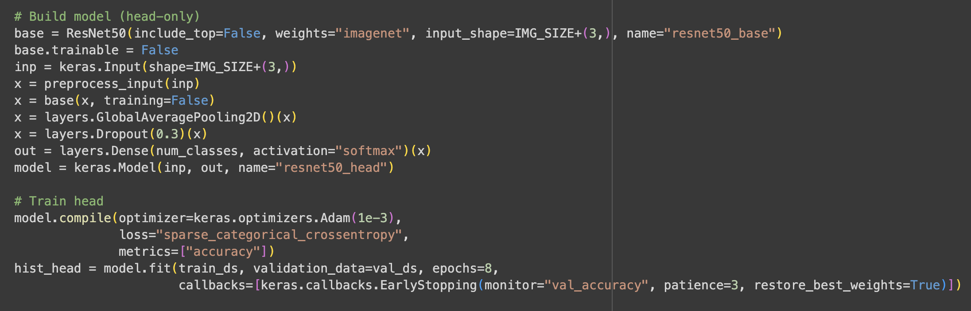
ResNet50

Slide 10
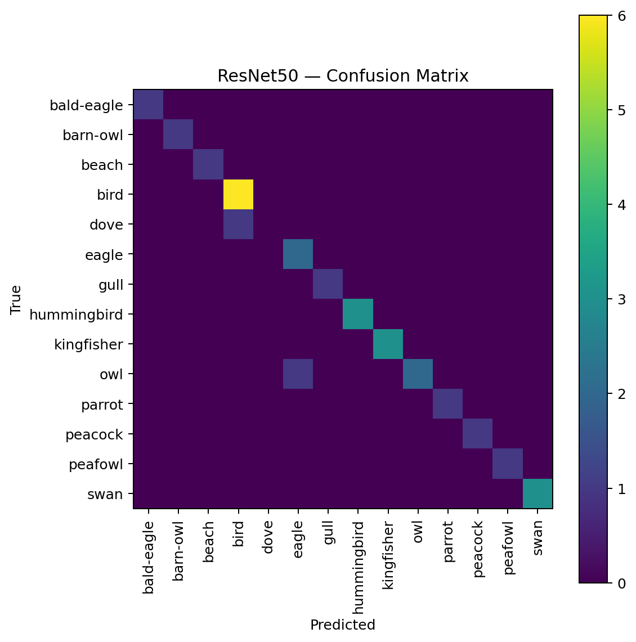
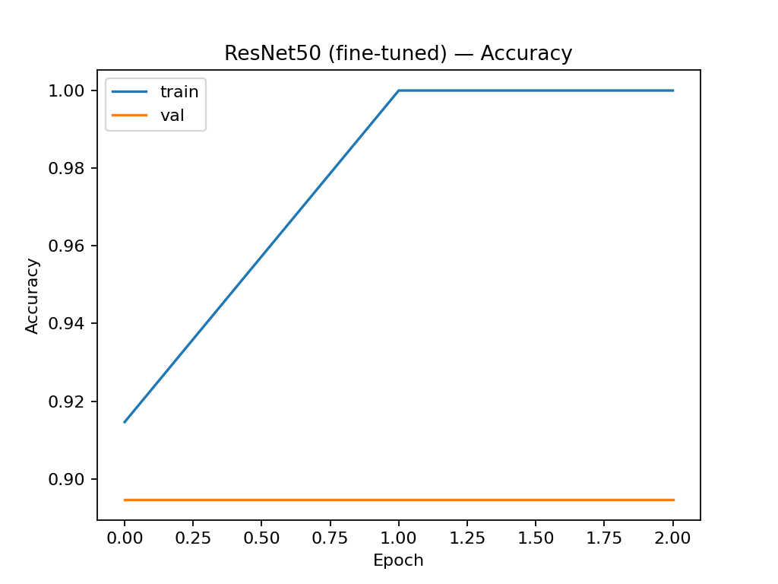
ResNet50 Results
Notes:
“ResNet50 performed much better than our CNN.
The graph shows both accuracy lines improving together, and the confusion matrix has a stronger diagonal — meaning the model recognized bird species more accurately.”
“So here, the blue line represents the training accuracy, which shows how well the model performed on the training data as it learned.
You can see that it starts lower but steadily improves over each epoch, meaning the model is actually learning useful features.
The orange line is the validation accuracy, which shows how the model performs on unseen test data.
Unlike our baseline CNN — where the orange line stayed flat — here it rises along with the blue line, which means the model is generalizing better and not just memorizing the training images.
That’s why this graph is a good sign — the ResNet50 model is learning and performing consistently on both training and validation data.”

Slide 11
Baseline CNN vs ResNet50
25%
50%
Baseline CNN
ResNet50
Overall accuracy
Key Observation: Underfit, flat accuracy
Overall accuracy Key Observation: Learned better patterns
Train Accuracy | ~25%
Val Accuracy | ~21%
Macro-F1 | 0.05
Train Accuracy | ~50%
Val Accuracy | ~45%
Macro-F1 | 0.22
ResNet50 nearly doubled accuracy and improved balance across classes, proving transfer learning was more effective.
Notes:
“Here’s our comparison slide. The Baseline CNN achieved around 25% accuracy, which means it struggled to learn patterns from the data.
When we switched to ResNet50, accuracy almost doubled to around 50%, and our F1-score improved four times over.
This shows how transfer learning helps smaller datasets perform much better.” Macro F1 is the overall score ““Macro-F1 is like an overall average score of how well the model did across all bird species.
A perfect score is 1, and ours was 0.22 — so about 22%. That means the model is learning but still misses a lot.”
Val Accuracy = Validation Accuracy Accuracy = how often the model is right overall.
Macro F1 = how fairly the model performs across all classes (bird types).
It tells you how well the model performs on data it has never seen before — a small part of your dataset that’s set aside during training.
“Validation accuracy shows how well the model can predict new bird images it wasn’t trained on.”
Why the macro f1 score is so low is because we only used ran the training code once and it only uses 10epoch. So we are at surface level stil.

Slide 12
Challenges
Small number of bird images made training difficult.
Limited dataset
Many species looked very similar (color, feathers, or beak shape).
Fine-grained differences
Many species looked very similar (color, feathers, or beak shape).
Slow training
Some species had fewer samples, causing biased learning.
Class imbalance
Notes:
The challenges that we faced was facing the limited size of dataset. Since we only had small numbers of bird images for each species, the model didn’t have enough examples to learn distinctive features effectively, results in many species looking very similar through color, feathers, or beak shape with fine-grained differences and slow training. Another challenges that we also face was class imbalance because, some species had fewer samples and cause it to underfitting.

Slide 13
What’s next
Add Data Augmentation
Try EfficientNet
Use a Larger Dataset
Build a Demo App/Site
Increase training variety with flips, rotations, and zooms to help the model generalize better.
Use a newer, more efficient architecture for higher accuracy with fewer parameters.
Test on bigger or higher-quality bird image datasets from Kaggle for more robust learning.
Create a simple demo where you can upload a bird photo and the model predicts its species.
01
02
03
04

Slide 14
References
He, K., Zhang, X., Ren, S., & Sun, J. (2016). Deep residual learning for image recognition. In Proceedings of the IEEE Conference on Computer Vision and Pattern Recognition (CVPR) (pp. 770–778).
Alswaitti, M., Zihao, L., Alomoush, W., Alrosan, A., & Alissa, K. (2022, March). Effective classification of Birds’ species based on transfer learning. International Journal of Electrical and Computer Engineering (IJECE).
Kumar, Akash. “Bird Species Classification.” Kaggle, 30 Sept. 2018, www.kaggle.com/datasets/akash2907/bird-species-classification.
Notes:
“To wrap things up our goal was to classify different bird species from images.
We started with a simple baseline CNN, which reached about 25 percent accuracy. That gave us a starting point to measure progress.
Then, when we switched to ResNet-50, our accuracy improved to around 50 percent showing how transfer learning really helps when your dataset is small.
From this project, we learned that pretrained models are much more effective for limited data, and that the more images we have, the better the model performs. We also saw how the graphs helps us understand where the model struggles.
For next steps, we’re going to change our datasets and use data augmentation with the model, maybe try a model like EfficientNet, and eventually create a small demo app or website where we can upload a photo and get the predicted bird species.”

